Slide 1
Hands-on Books-Closed: Islamic Studies Unit Using Technology & Service Learning
Presented by Tatiana Coloso, Aishia Neal, & Rana Issa

Slide 2
Our Team
Al-Iman School
Tatiana Coloso
Aishia Neal
Rana Issa
Raleigh, NC
Islamic Studies Teacher
Instructional Coach
Islamic Studies & Arabic Teacher
Al-Iman School shall provide an Islamic environment that offers quality education and leadership skills to develop global awareness and 21st Century skills.

Slide 3
“
“
“Student achievement at the end of the year is directly related to the degree to which the teacher establishes good control of the classroom procedures in the very first week of the school year.”
Harry Wong 2009

Slide 4
Examples of Routines & Procedures
Arrival
Schedules
01
What are the classroom procedures when arriving to class? What should they do or where should they go?
04
Is it time yet?
Completed Task
Group Work
02
05
What are the procedures when working in groups?
When a task is completed early what shoudl a student do?
Getting Help
Dismissal
03
If a student needs help, how should they get it? What if the teacher is unavailable?
06
What are the classroom procedures for the end of the day? Announcments, dua, location, etc.

Slide 5
“
“
“A teacher delivering instruction without standards, is like a sailor rowing a boat without an oar.”

Slide 6
Steps To Organizing A Unit
Step #1
A “Big Idea” is an enduring point, or an idea that a teacher wants students to understand by the end of the unit.
Understanding the “Big Idea”
Step #2
Harry Wong describes standards as being the backbone of the curriculum because they tell the teacher what students are to master (Wong, 2009).
Identify Standards & Objectives
Step #3
Solidifying a strong plan for both the beginning and end of the unit gives the teacher necessary parameters for creating the lessons that support the Big Idea.
Conclude, Introduce, Build

Slide 7
Standard or Objective
What is the objective of this unit?
2. Conclusion
How are you going to end your unit?
What will the summative assessment be?
Big Idea!
3. Introduction
How will you introduce the unit?
4. Building The Unit
What activities will you use?

Slide 8
“
“
…It is becoming valuable as ever to integrate technology into our instruction, exploration, and assessments.

Slide 9
Why integrate technology?
Engagement
Technology increases student engagement and excitement.
Knowledge
Different Learning Styles
Technology puts knowledge right at the students finger tips.
Touches on all learning styles from auditory to kinesthetic learners
Time Saver
Saves time in the long run on creating assignments and grading assessments.
Global Link
Technology links students to the world.

Slide 10
Mobile Style
Examples
Quizlet
Quizlet can be used on any mobile device for quick review, grading, games, etc.
Kahoot
Kahoot is great for class competitions and reviews.
Nearpod
Nearpod is wonderful for teaching new lessons, traveling the world on interactive field trips and assessments.
iPads/Tablets
Cell Phones/iPods

Slide 11
NetBook Style
Flipped Classroom
GoPaperless
Collaboration
Share Presentations
Quick Feedback
Communication
Student Portfolios
Google Classroom is a great start for beginners!

Slide 12
“
“
““The similitude of believers regarding mutual love, affection, fellow-feeling is that of one body; when any limb of it aches, the whole-body aches, because of sleeplessness and fever.”
Muslim

Slide 13
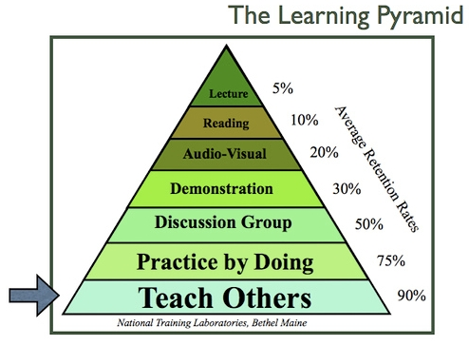
Service Learning Projects
"A form of experiential education where learning occurs through a cycle of action and reflection as students seek to achieve real objectives for the community and deeper understanding and skills for themselves.”

Slide 14
Stages To Organizing A Project
Investigation
1
Demonstration
5
2
Planning
Reflection
4
3
Action

Slide 15
Service Learning Ideas
Community Park Clean-up
Adopt An Orphan
Homeless Shelter Service Day
Animal Shelter: Blankets for Paws
Refugee ELL Classes
Blankets For Refugees
Hygiene Packages
Hijab Awareness Day

Slide 16
Technology is used to research a problem in the classroom to gain knowledge and explore current issues.
Technology Integration
The Big Idea
Service Learning Projects
Service Learning takes the Big Idea a step further. Students have first hand experiences and their efforts come to life.

Slide 17
Contact Us At
tatiana.coloso@alimanschool.org
aishia.neal@alimanschool.org
rana.issa@alimanschool.org
Sweetilm.weebly.com
teacherspayteachers.com/Store/Sweet-ilm
www.pinterest.com/sweetilm/

